Slide 1
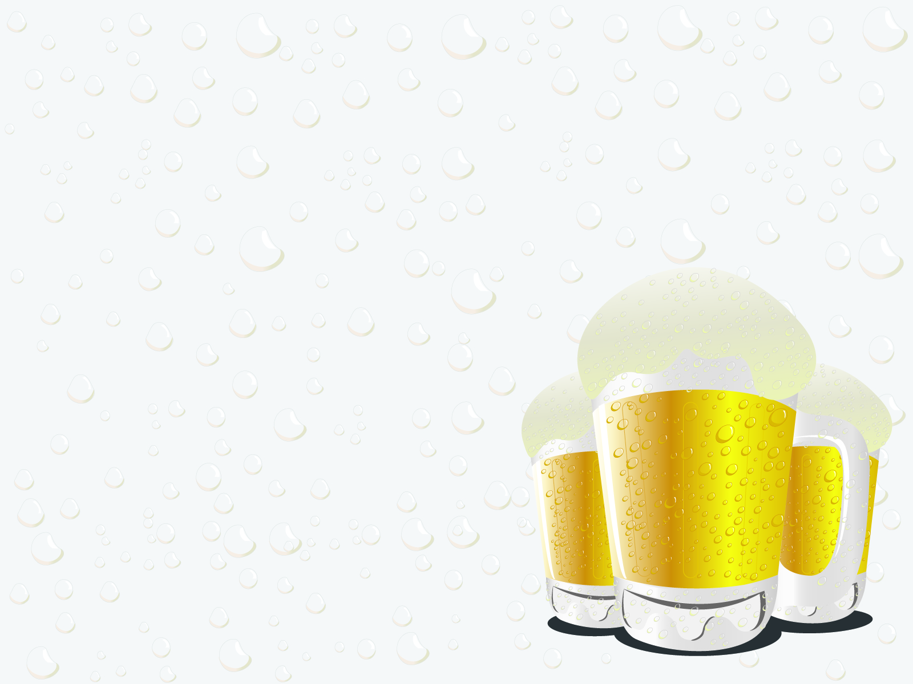
Beer O’Clock Company
Analysis of Competitor ABV & IBU
Content and Correlation between ABV & IBU
February 26, 2019
Shane Weinstock & Tom Gianelle Inc.

Slide 2

“Just because you can put a pound of hops into a beer, doesn’t mean you should.” Trademark Pending
Beer O’Clock is pursuing a product that goes against the current hoppy trend. The goal is to offer a product that has a larger alcohol content by volume (ABV)than the mean of the current market, while being below IBU mean bitterness level that comes from hops.
This is a study the of the ABV and the International Bitterness Units (IBU) contained in your competitors’ products.

Slide 3

Research
Goal
The goal is to determine how the Beer O’Clock’s new product (high ABV and lower IBU) will compare with the competition’s products and the correlation to ABV vs IBU impact on creating target product.
Beer O'Clock is planning to initially offer new beer in it’s base state of Texas, but is also interested in selling the new product in other nearby states:
Arkansas
Louisiana
Oklahoma

Slide 4
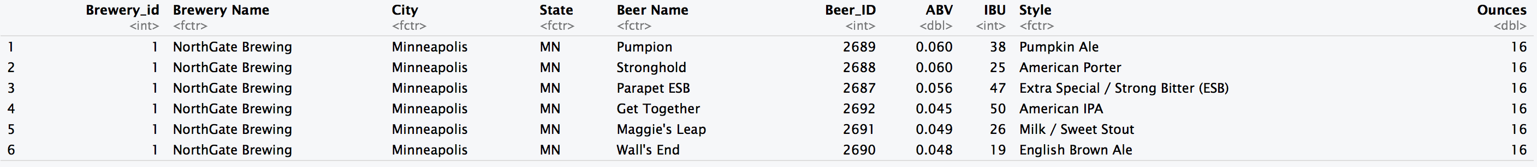
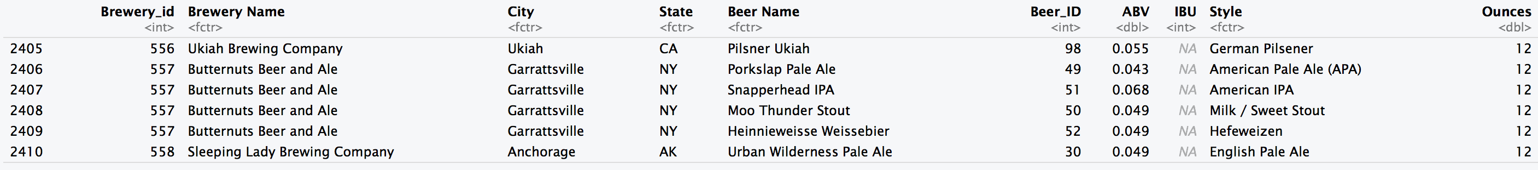
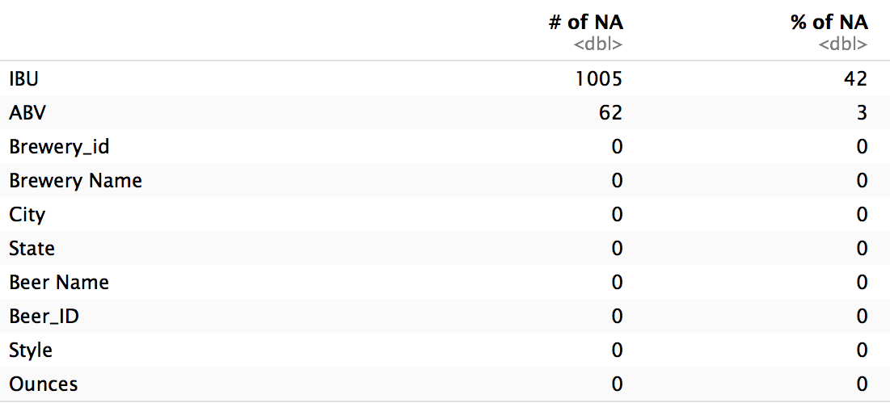
First Steps – Data Analysis
The analysis was completed utilizing the provided brews.csv and breweries.csv files.
Below is sample of first 6 & last 6 combined data. In addition, the number of NA’s that were needed to be removed from study.
Source: brews.csv & breweries.csv

Slide 5
Next Steps – Research Findings
We first wanted to gain an insight of our competition as we know what state we will begin our operation in. We drew a sample of current brewery and beer data to conclude the following.
State | Number of Breweries | Ranking
TX | 28 | 5
OK | 6 | 27
LA | 5 | 30
AR | 2 | 44
For the target markets, the table show the ranking by number of breweries and count of breweries by state.
Source: Appendix A breweries.csv

Slide 6
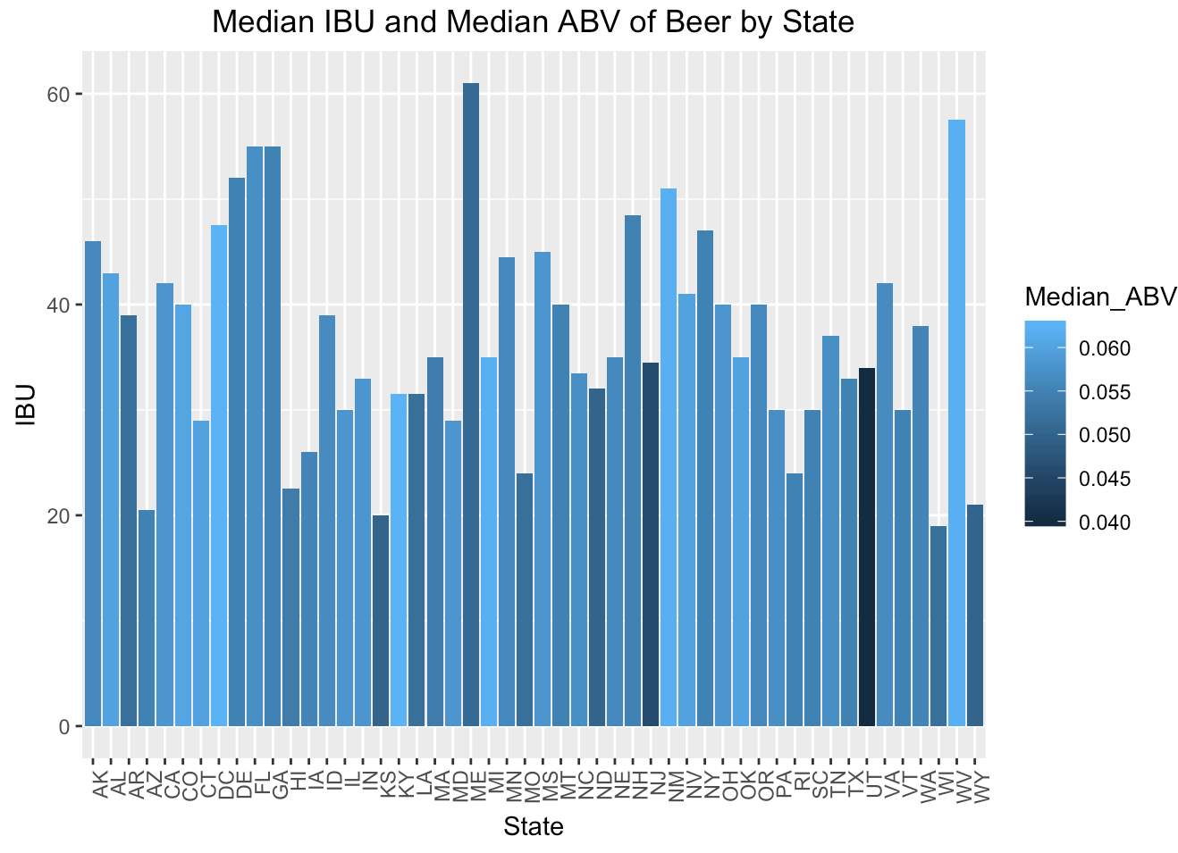
In viewing this chart it was determined it would be helpful to view data separately by state

Slide 7
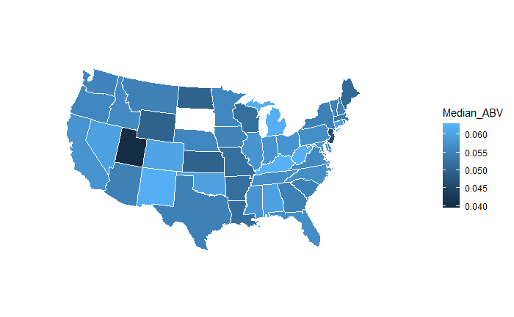
Analysis
ABV - Statewide Comparisons
As now we now know there’s a correlation, we examined the states “Beer O'Clock” wanted to introduce a product
This helps us better understand how the new product will stand out in the current market data.
In this chart for example, we can see that Texas has a generally higher than average median ABV. AR, CO and LA are even higher median ABV. Only OK has a lower ABV.
In target markets, the ABV planned in new product will be only slightly higher than the median ABV in beers produced by competitors.
Source: brews.csv

Slide 8
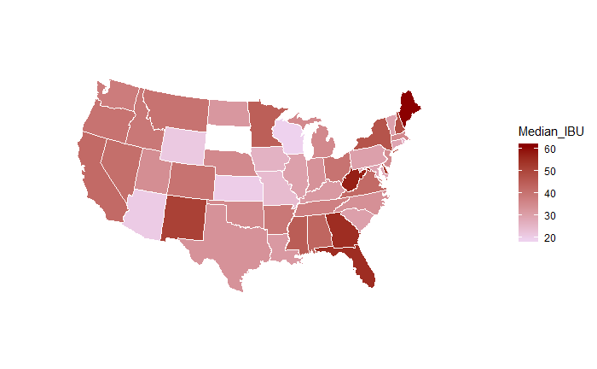
IBU - Statewide Comparisons
Analysis
As we continue our comparison to examine the IBU market, we can see that AR, OK. TX are are at the median IBU level. LA is slightly lower and CO is very low.
Matching a product that is highly produced in CO could provide a unique product to the company’s other target markets (AR, LA, OK, TX).
Source: brews.csv

Slide 9
Brewers & Beers with
Max IBU and ABV values
We wanted to examine the products and the locations of the max values for both variables we’d been observing.
MAX IBU: Astoria, OR produces the highest IBU at 138 as an American Double/Imperial IPA from Astoria Brewing Company with a beer named the "Bitter Bitch Imperial IPA".
MAX ABV: Boulder, CO produces the highest ABV at 12.8% from brewery Upslope Brewing Company for beer Lee Hill Series Vol. 5 - a Belgian Style Quadrupel Ale.

Slide 10
Research Findings – Summary Statistics
Diving into this we wanted to run some basic analysis and find our benchmarks and possibly any initial correlations that we might be able to conclude:
Medians: ABV = 0.056 IBU = 35
Means: ABV = 0.059 IBU = 42.71
Max: ABV = 0.128 IBU = 138
SD: ABV = 0.013 IBU = 25.95
.
Source: brews.csv

Slide 11
Research Findings – Summary Statistics by Target Markets
.
Source: brews.csv

Slide 12
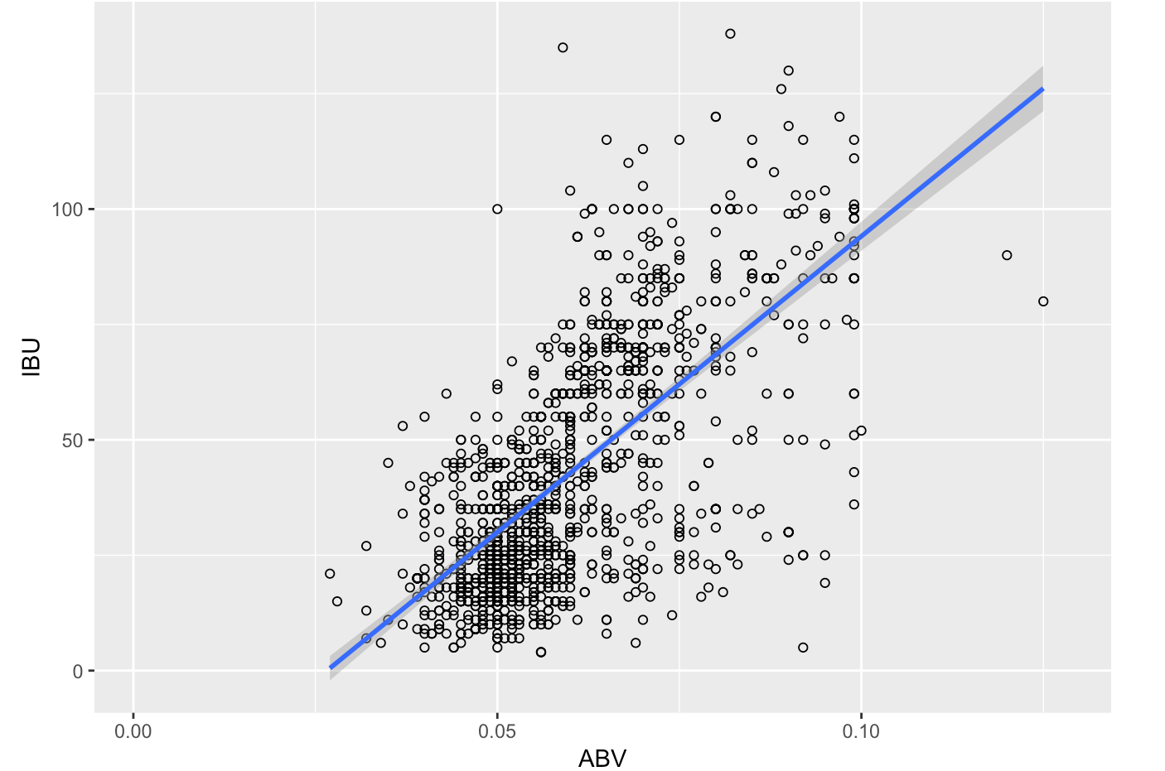
The ‘Hops’ Analysis
We next examined if a correlation exists between IBU and ABV. This way we could understand if our bitterness derived from hops would influence the ABV.
After computing the covariances of IBU and ABV, we observed a 67% relationship between the two variables. Allowing us to conclude that there is statistical significance to believe that a higher level of hops (or bittering agent) will also yield us a generally higher ABV.

Slide 13
Conclusion
Based on the data that is provided, we can conclude that:
Given the high (42%) of NA’s in data, it is difficult to provide any certainty on the entire brews population. For the available data there did show a 67% correlation between ABV & IBU.
Colorado has the highest number of breweries in nation, and it’s breweries produce beer with median ABV and IBU that are similar to your new product goals.
Matching a product that is highly produced in CO could provide a unique product opportunity to the company’s target markets (TX, AR, LA, OK).

Slide 14
_{Appendix A}
.
Source: brews.csv

